Slide 1
Curriculum Night 2019
Ms. Lynne Dallmann ☺
Kindergarten Room A7

Slide 2
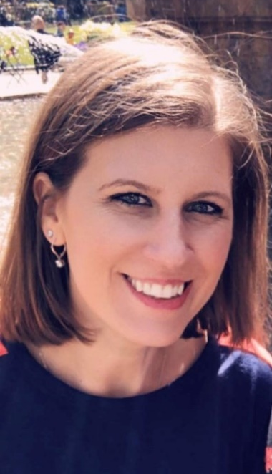
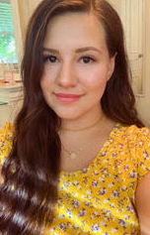
Lynne Dallmann
Arianna Martinez
16th year teaching
19th year in education
Student Teacher
Goes to Wayne State

Slide 3
Math
Ferndale uses Envisions Math as its primary tool for math instruction. Children learn best through hands-on activities, manipluatives, visual activities, and some online experiences which is how the follow units will be taught:
Build Number Patterns and Meaning
Build Number Sense and Comparing Numbers
Know number names and the count sequence
Count to tell the number of objects
Measurement (Length and Time)
Organizing and Representing Data
Geometric Shapes, Patterns, and Attributes
Work with numbers 11-19 to gain foundations for place value
Addition and Subtraction

Slide 4
Language Arts
Phonemic Awareness and reading are the most important skills that your child will develop in kindergarten. Children learn to read by reading and rereading meaningful material. We will do this through a variety of songs, chants, poems, charts, and books during literacy centers.
We will begin with familiar patterns and that are predictable then move into phonics and phonetic instruction. This will help your child develop more complex sound and symbol awareness.
This year we are moving to Journeys for our reading and writing curriculum. Combines: big books, shared and independent practice and guided reading.

Slide 5
Science
Units
  Weather
  Plants/Animals (Living vs Nonliving)
  Force and Motion

Slide 6

Homework
Reading
  Read to and with your child every night
Sight Words (reading and spelling)
    Sent home every few weeks to practice at home
Projects
  Work on with your child to support home-school connection

Slide 7
Classroom Discipline
I believe that in order to have a nurturing classroom environment, children need positive reinforcement for positive choices and consistent consequences for inappropriate choices. It my hope and plan that as a team of parent/guardian and teacher, we will work together to help your child grow and make responsible choices that affect themselves and those around them.
I believe in open, two-way communication, so please do not hesitate to contact me should there be any concerns or questions.

Slide 8
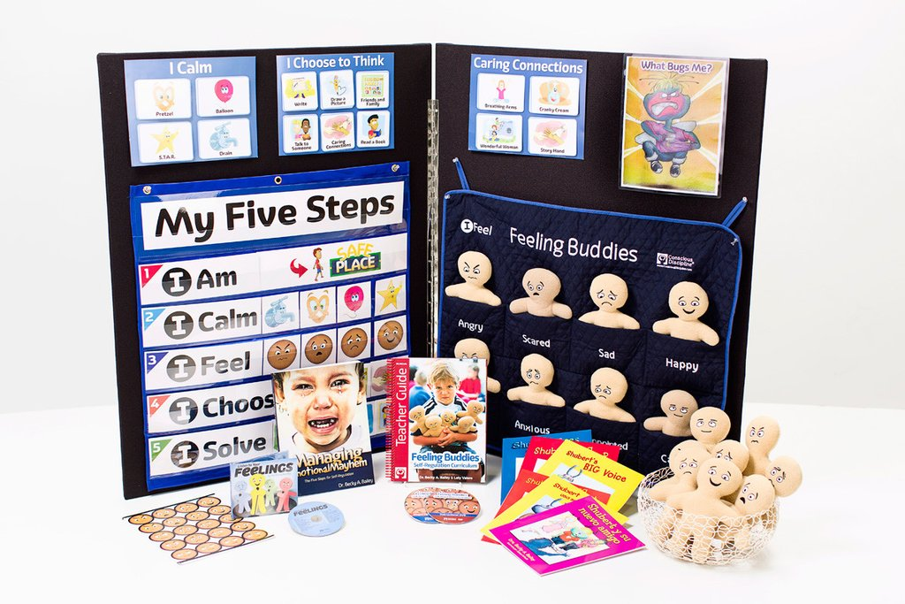
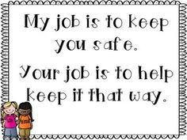
Social Emotional Learning
Ferndale Lower Elementary uses Conscious Discipline, along with Feeling Buddies in Kindergarten. This curriculum teachers our students the skills necessary to create a safe learning environment in the classroom and at school. We also teach our students how to problem solve and self regulate.

Slide 9
Kindergarten Development
Children Need Help with Words and Actions
“You’re not my friend!”, “I don’t like you!” or “You’re mean!”
Birthday party
Still developing internal voice
Still impulsive
“I don’t like it when you ______. Next time ______.”
“When you _______, I felt ________. Next time ________.”
5 Year Olds Are Still Egocentric
•Not to mean that they are negatively self-centered, but they think that everyone views the world in the same way they do.
They lack perspective in that way.
•Mistake vs. On purpose

Slide 10

Seesaw
Personal student journal
Place for each child to document their learning
Student/Parent/Teacher connection
Place for classroom reminders
Free for families to use

Slide 11
Volunteering
Handout on Center Expectations
  Please arrive on time!
  Online sign-up
Everyone must fill out a Volunteer Registration Form
  Even for Field Trip, Centers, or attending parties.

Slide 12
Important Contacts
Class Coordinator
  Still need one!!!
    Will be creating and sending out online volunteer sign-up schedules
    Will create class play date contact list
Party Planners
  Veronica Kisor- Anyone want to help her?
    Will plan parties (Halloween, Winter Holidays, Valentine’s, End of year)
    Will be contacting parents to volunteer at parties and help donate snacks and supplies

Slide 13
Times & Specials
Lunch
  12:35-1:30
Specials
  Art: Thursday
  Gym: Wednesday and Friday
  Music: Monday and Tuesday
  Media 2.0: Monday
  Music Therapy: Tuesday

Slide 14
This and That
Lunch/Milk Money – You can put money in your child’s account online. If needed you can also send in a plastic bag or envelope with your child’s name on it, I turn it in in the morning, if students don’t turn it in, I cannot be responsible for money.
Water bottles - send everyday. If possible children can keep in the classroom.
Snacks – We use a community snack. A snack schedule will be sent home monthly with your assigned day.
***We are a SESAME and NUT-RESTRICTED school, please check all labels before sending community snacks.***

Slide 15
Questions
Q & A

